Slide 1
GLOSOLAN PT 2022: global outcomes and perspectives
Christian Hartmann
GLOSOLAN steering committee
IRD – France

Slide 2
Context:
<<The mandate of the GSP is
to improve governance of the limited soil resources
of the planet
What you cannot (correctly) measure,
you cannot (correctly) manage.

Slide 3
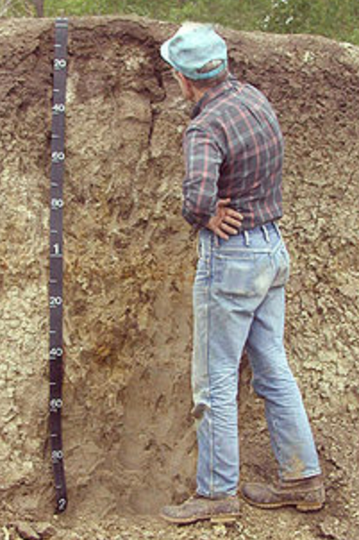
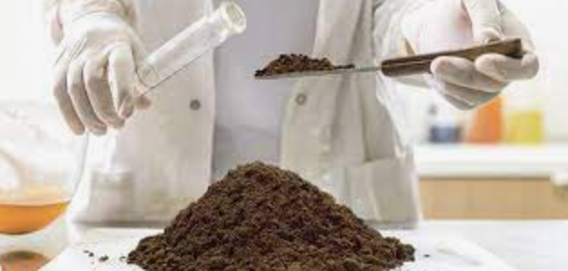
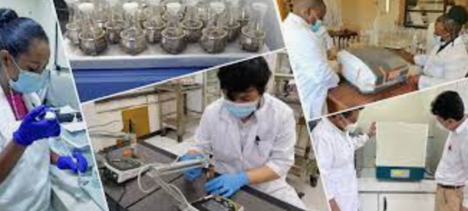
(PHOTO WIKIPEDIA)
(PHOTO WIKIPEDIA)
Soil data can be obtained in different ways
Many data come from by soil laboratory analysis
=> data provided by soil laboratories are essential for soil governance

Slide 4
Soils are essential for food production:

Slide 5
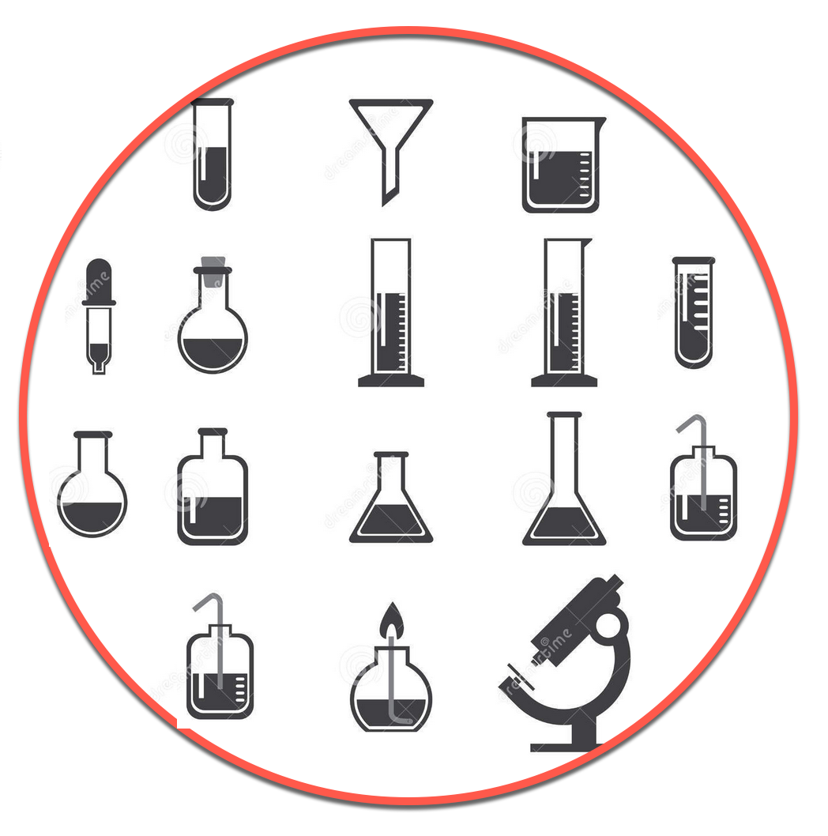
Soils are essential for food production:
Laboratories are essential for soil data production
Soil labs:
where soil data begins

Slide 6
Soils are essential for food production:
Laboratories are essential for soil data production
Soil labs:
where soil data begins
The good news : soil labs already exist all around the planet

Slide 7
Soils are essential for food production:
Laboratories are essential for soil data production
Soil labs:
where soil data begins
The good news : soil labs already exist all around the planet
The bad news: soil labs are working without coordination among them…

Slide 8
Soils are essential for food production:
Laboratories are essential for soil data production
Soil labs:
where soil data begins
The good news : soil labs already exist all around the planet
The bad news: soil labs are working without coordination among them…
An option for improvement:

Slide 10
The 900 labs that are GLOSOLAN members ☺

Slide 11
The 900 labs that are GLOSOLAN members ☺
For 5 years now GLOSOLAN helped these labs producing reliable and comparable soil data
by providig SOPs, video explaining SOPs, trainings, webinars, technical publications, etc…

Slide 12
For 5 years, GLOSOLAN has been helping soil labs producing reliable and comparable soil data
by providing SOPs, video explaining SOPs, trainings, webinars, technical publications, etc…
Now GLOSOLAN questions are:
1. How reliable and comparable are the data produced by soil laboratories?
2. How can GLOSOLAN help all labs to reach a minimum data quality?

Slide 13
Part 1 = assessment:
how reliable and comparable are
the data produced by soil laboratories?

Slide 14
Launching a global (planet) proficiency testing (PT)
or inter-laboratory comparison.
The PT design was decided according to:
our QUESTIONS (reliability / comparability)
& FEASABILITY
(number of soil types, cost of preparation including irradiation,
cost of sending worlwide, etc)

Slide 15
QUESTIONS: 2 + 1 more
RELIABILITY: for each lab, what is its precision?
(i.e. when analysing several times the same sample,
how close are the results?)
2. COMPARABILITY: among all labs, dispersion of their results?
(i.e. when the same sample is analysed by several labs,
how close are the results?)
3.

Slide 16
QUESTIONS: 2 + 1 more
RELIABILITY: for each lab, what is its precision?
(i.e. when analysing several times the same sample,
how close are the results?)
2. COMPARABILITY: among all labs, dispersion of their results?
(i.e. when the same sample is analysed by several labs,
how close are the results?)
3. REFERENCE VALUE : at global scale, consensus value = reference value?
(i.e. on a statistical and practical view point,
can we provide samples with reference values acceptable worldwide?)

Slide 17
FEASABILITY:
Which soil characteristics?
2. How many replicates?
3. Which range?

Slide 18
FEASABILITY:
Which soil characteristics?
pH: top priority but difficult because to much soil weight is needed

Slide 19
FEASABILITY:
Which soil characteristics?
pH: top priority but difficult because to much soil weight is needed
C: top priority because
- soil is a main compartment in C cycle… global warming…
- and…

Slide 20
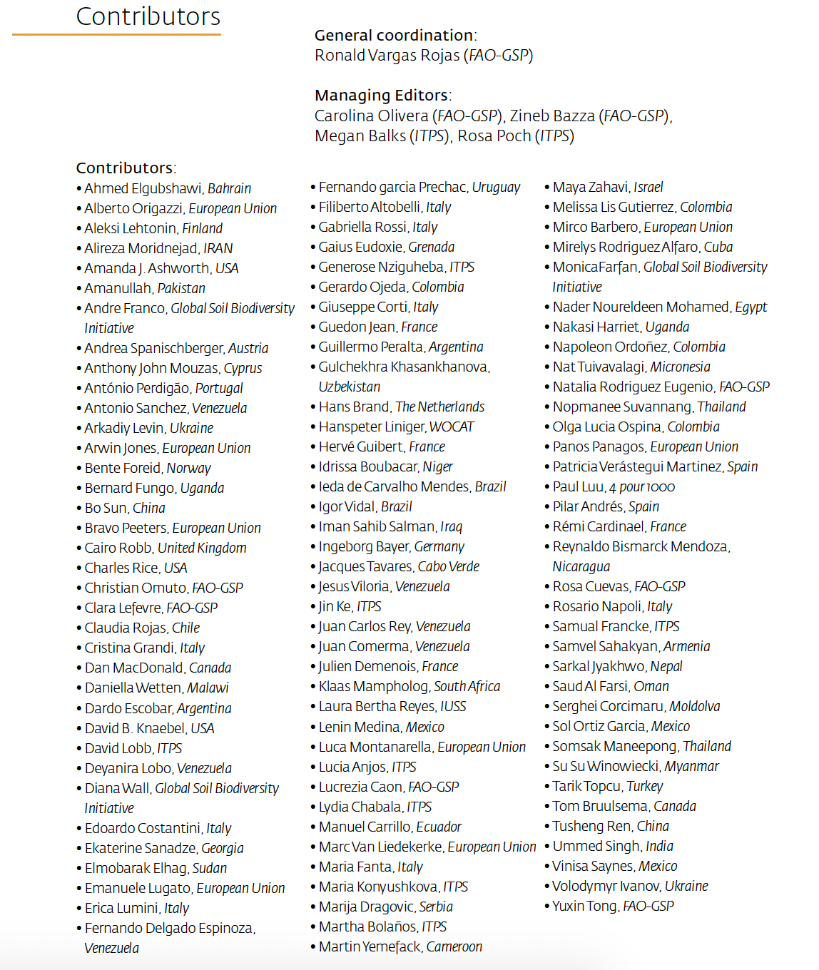
List of contributors:

Slide 21
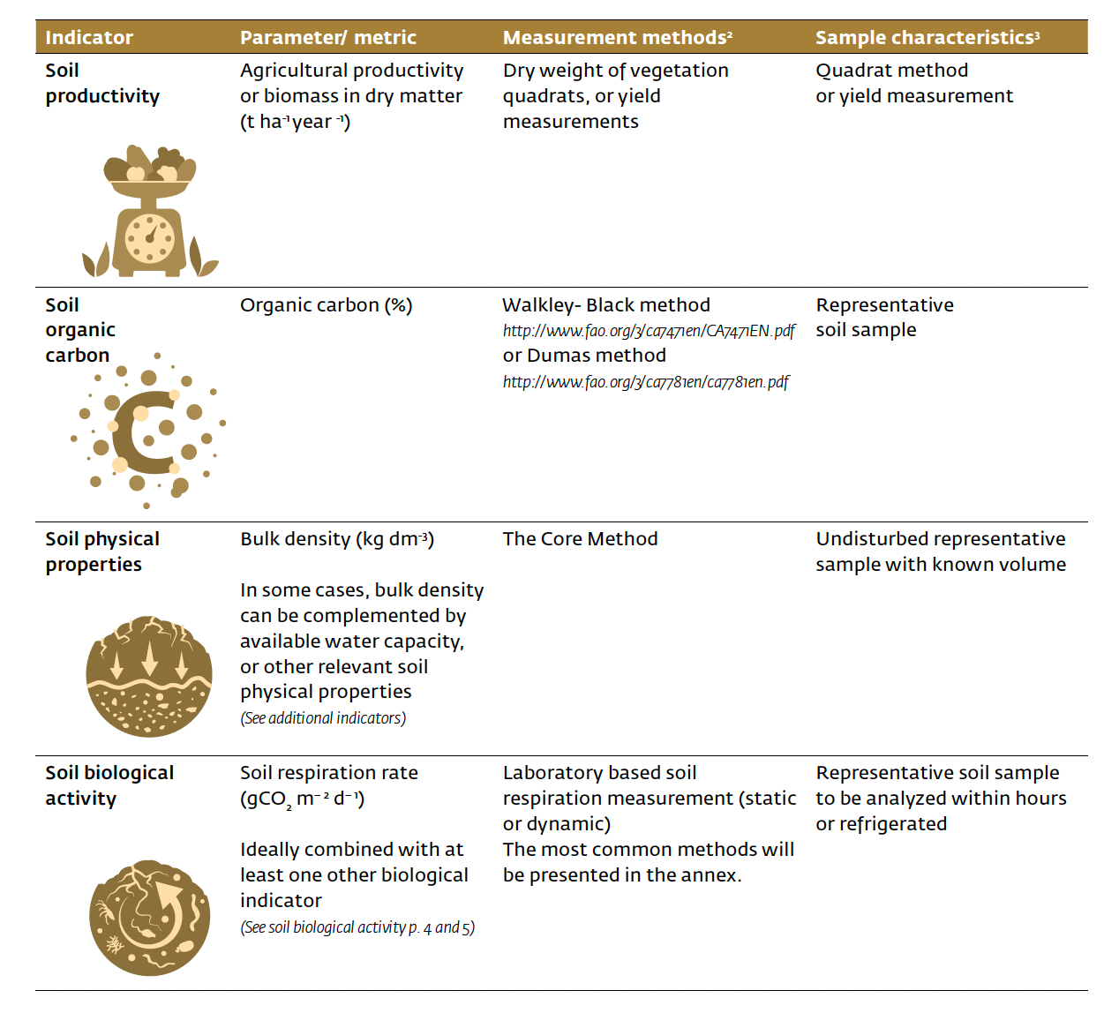
List of contributors:

Slide 22
FEASABILITY:
Which soil characteristics?
pH: top priority but difficult because to much soil is needed…
C: top priority because
- soil is a main compartment in C cycle
- and « Protocole of assessment of sustainable management »
- low soil amount is needed
N & P: main factors of productivity / negative impact on environment
low soil amount is needed

Slide 23
FEASABILITY:
Which soil characteristics?
pH: top priority but difficult because to much soil weight is needed
C: top priority because
- soil is a main compartment in C cycle
- and « Protocole of assessment of sustainable management »
- low soil amount is needed
N & P: main factors of productivity / negative impact on environment
low soil amount is needed
Which methods?

Slide 24
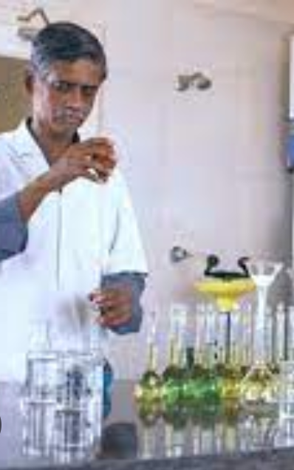
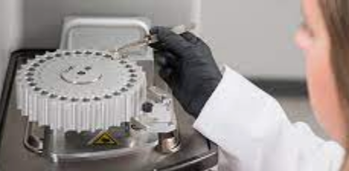
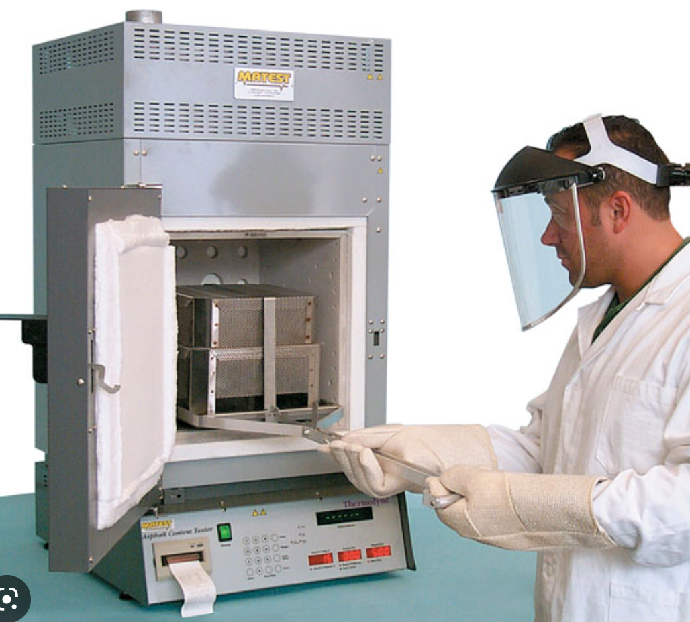
≠ METHODS
≠ TOOLS
Walckley & Black
Wet chemistry
Carbon
Dumas
Combustion (controled atmosphere)
Loss of ignition
Combustion (450-550°C)

Slide 25
≠ METHODS
≠ TOOLS
For some methods,
≠ procedures are possible
duration
Walckley & Black
Wet chemistry
Carbon
NA
Dumas
Combustion (controled atmosphere)
Loss of ignition
Temperature
Combustion (450-550°C)

Slide 26
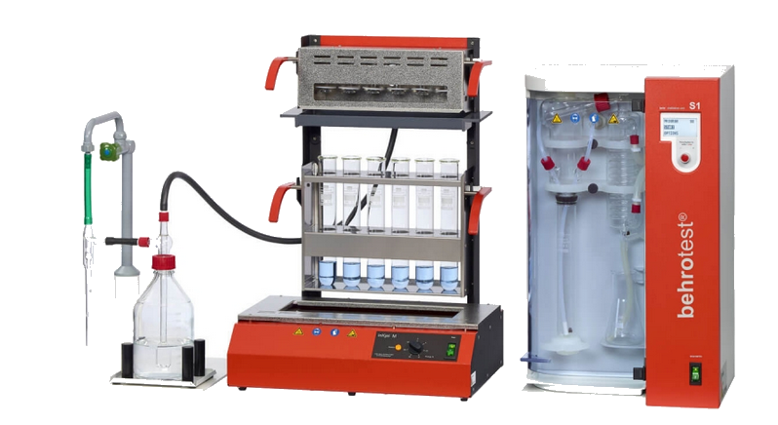
≠ METHODS
≠ TOOLS
For some methods,
≠ procedures are possible
Kjeldahl
Wet chemistry
Soil characteristic
Nitrogen
Dumas
Combustion (controled atmosphere)

Slide 27
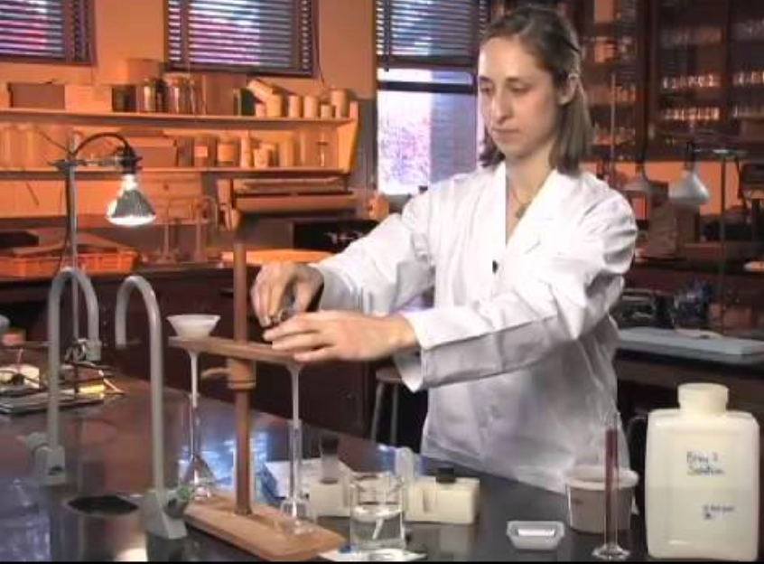
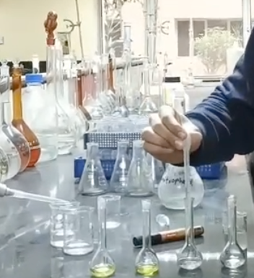
≠ METHODS
≠ EXTRACTANTS
For some methods,
≠ procedures are possible
Olsen
0.5 M NaHCO3 solution,
adjusted at a pH of 8.5.
Phosphorus
Bray 1
0.03 M NH4F and 0.025 M HCl
shaking times
Bray 2
0.03 M NH4F + 0.1 M HCl

Slide 28
FEASABILITY:
Which soil characteristics? C N P
2. How many replicates?

Slide 29
2. How many replicates?
Enough rep. to be able to make a statistical analysis,
Not to much to avoid reduced efficiency
6 rep:
A B C D E F
Comparability
Compare all labs
Reliability
of each individual lab

Slide 30
2. How many replicates?
Enough rep. to be able to make a statistical analysis,
Not to much to avoid reduced efficiency
6 rep:
A B C D E F
Comparability
Compare all labs
Reliability
Estimated through PRECISION
of each individual lab
Is the analytical process under control?
or is random

Slide 31
WHY PRECISION IS IMPORTANT:
If you go up and down your balance,
you expect the same result everytime

Slide 32
WHY PRECISION IS IMPORTANT:
If you make several times the test (within short time)
You expect the same result

Slide 33
5 REPLICATES
5 times the same result?
(comment:
relevant, whatever the method and procedures used by the labs)

Slide 34
FEASABILITY:
Which soil characteristics? C N P
2. How many replicates? 6 soil types & 5 rep for one soil

Slide 35
FEASABILITY:
Which soil characteristics? C N P
2. How many replicates? 6 soil types & 5 rep
3. Which range?

Slide 36
FEASABILITY:
Which soil characteristics? C N P
2. How many replicates? 6 soil types & 5 rep
3. Which range?
LOW to HIGH carbon content

Slide 37
FEASABILITY:
Which soil characteristics? C N P
2. How many replicates? 6 soil types & 5 rep
3. Which range?
LOW to HIGH carbon content
0.2 to 6 % carbon

Slide 38
FEASABILITY:
Which soil characteristics? C N P
2. How many replicates? 6 soil types & 5 rep
3. Which range? 0.2 to 6 % carbon
A B C D E F
E
10 SOIL SAMPLES
E
E
E

Slide 39
After you sent the analysis , still a lot of work was done
Processes with customs for ‘difficult’ countries
Contact the labs that were late
Contact the labs that did not follow the recommandations (no C data…)
Make the statistical analyse and check
Individual lab performances
Regional performances
etc…

Slide 40
GLOBAL RESULTS

Slide 41
Statistical procedure
----
Consensus values

Slide 42
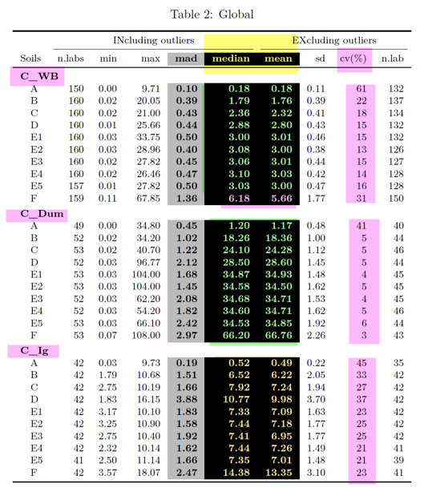

Slide 48
Precision

Slide 49
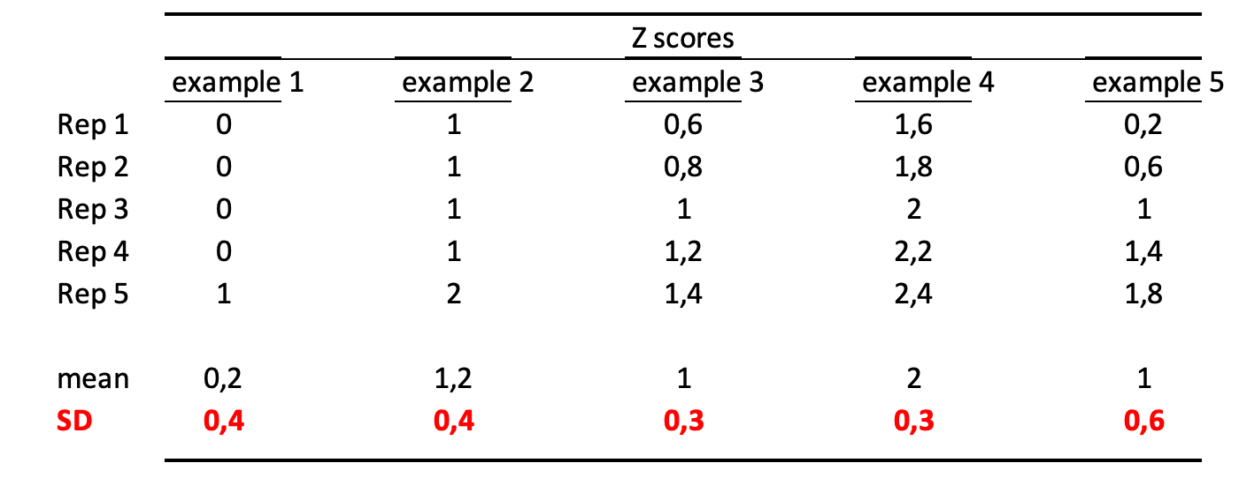
Precision: interpretation of Z-score standard deviation (sd)

Slide 50
Carbon

Slide 51
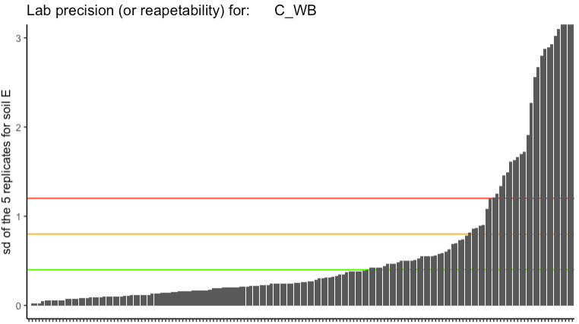
Standard deviation
(sd)
1.2
0.8
0.4

Slide 53
OK
the analytical process
is under control

Slide 54
OK
Half have
problems

Slide 55
OK
Some have very
serious problems
Half have
problems

Slide 56
OK
Half have
problems
Analytical problems or transcription problems?
Anyway clients gets low quality
and unreliable data

Slide 57
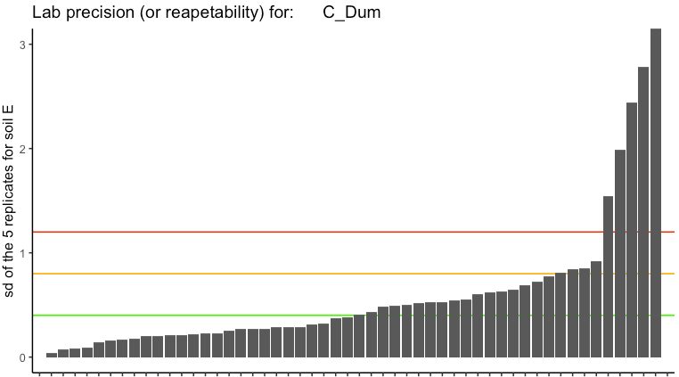

Slide 58
Using high tech. instruments but still problems => human factor?

Slide 59
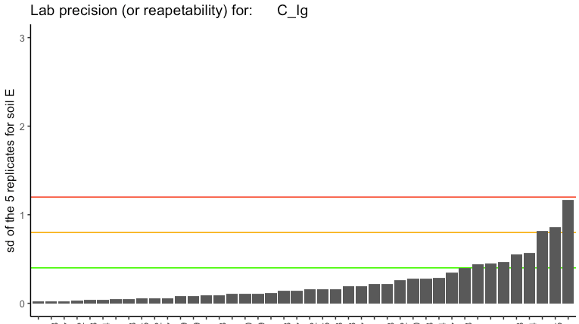
Majority is OK but unreliable method

Slide 60
Nitrogen

Slide 61
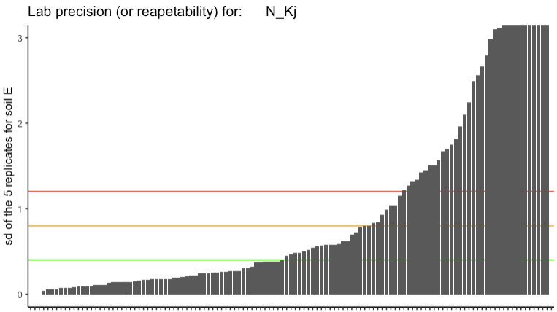

Slide 62
Many have very
serious problems
> half have
problems

Slide 63
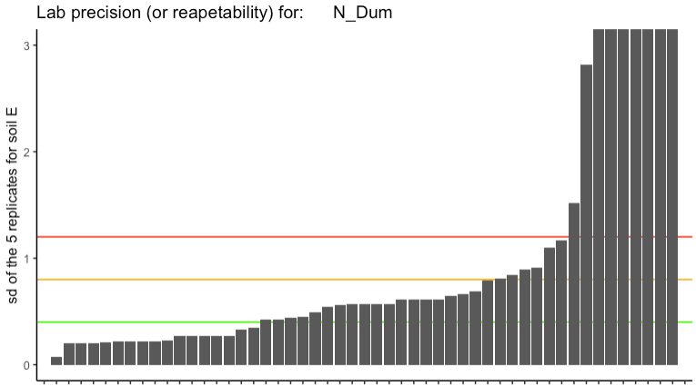

Slide 64
Using high tech. instruments but still problems => human factor?

Slide 65
Phosphorus

Slide 66
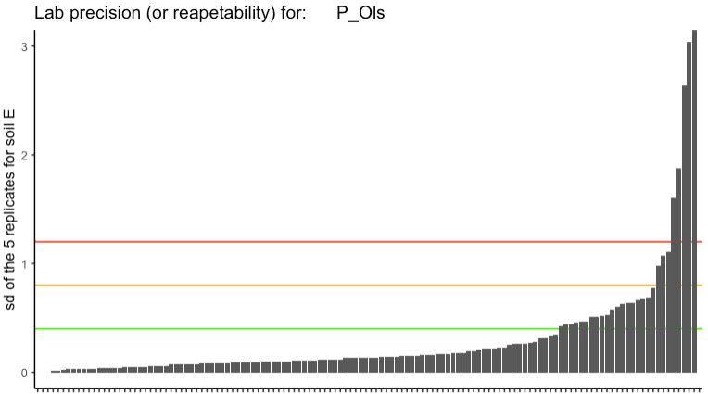

Slide 67
Few labs still had serious problems
A majority is OK ! ☺

Slide 68
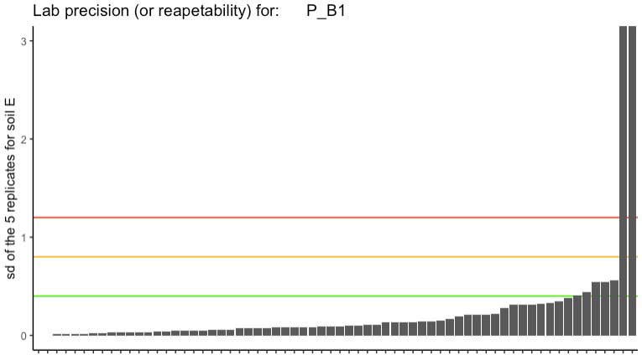

Slide 69
Marginal
problems
A large majority is OK ! ☺ ☺

Slide 70
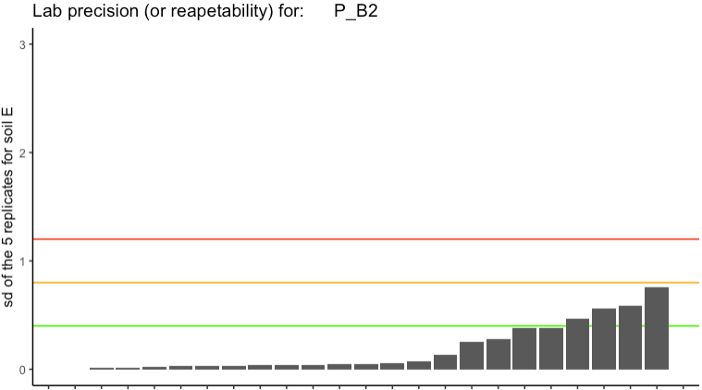
Nearly all labs are OK ! ☺ ☺

Slide 72
Comparability
& accuracy
How distant/different are the results from each lab
Compared to the consensus value.

Slide 73
Carbon

Slide 74
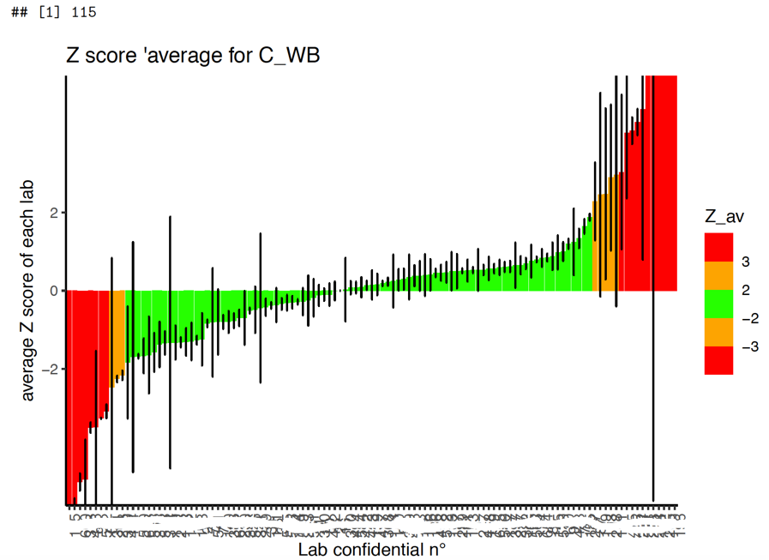

Slide 75
Average of the 10 Z score for the 10 analyses made
Possible to calculate a standard deviation:
+ short error bar: similar performances for all 10 samples (even the 2 extreme values)
+ long error bar: different performances

Slide 76
By chance some labs have an good average performance but indeed the performances different (very different) between samples
=> It was useful to have a large range of content
Whatever the difficulty of the method, some labs made it very well for a large range of C content.

Slide 77
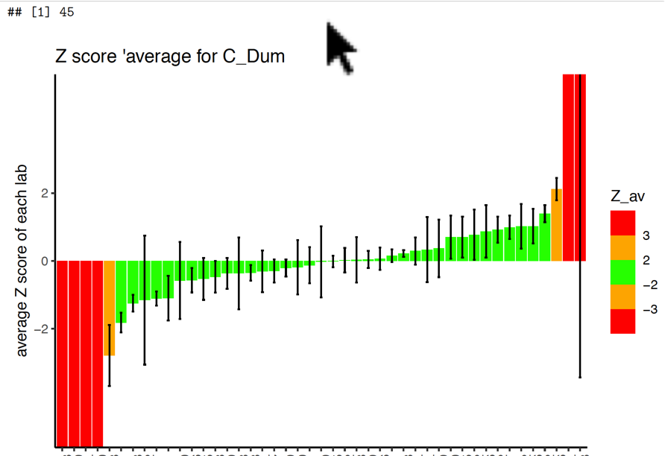
Technology cannot solve all problems!
The human factor is important too

Slide 78
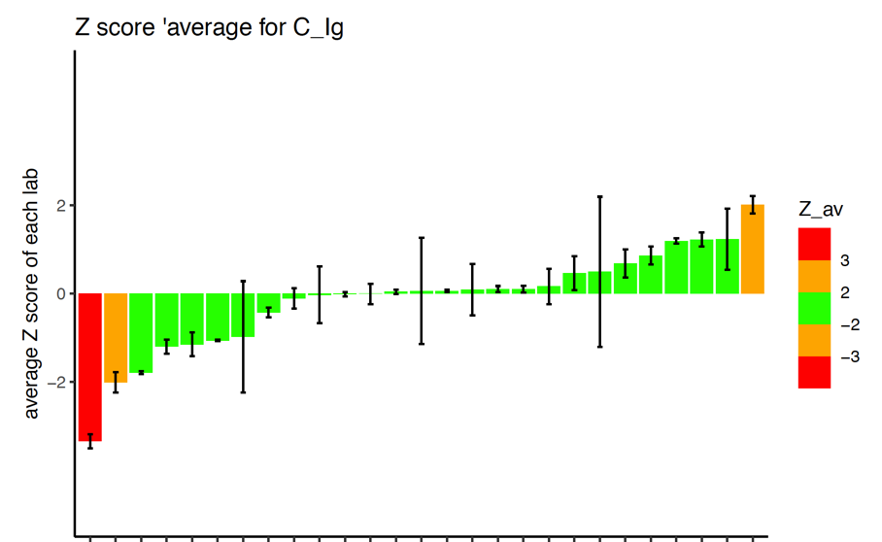

Slide 80
Nitrogen

Slide 81
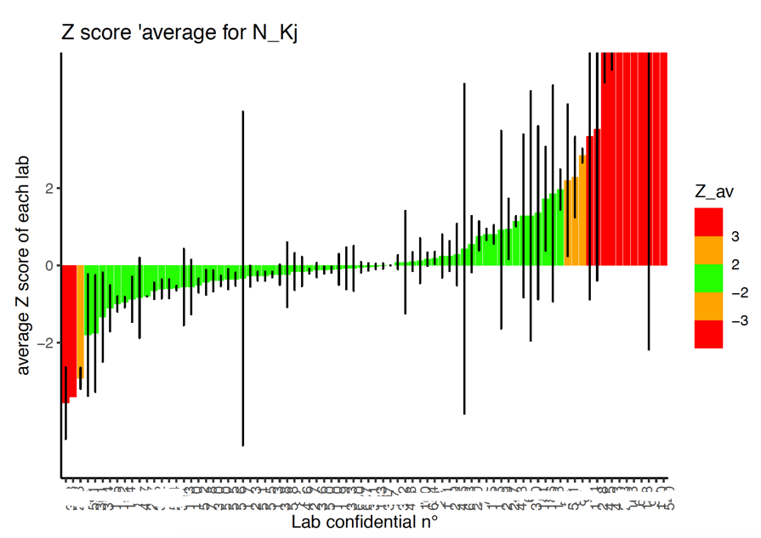
High perf.
Medium perf.
Low perf.
Low perf.

Slide 82
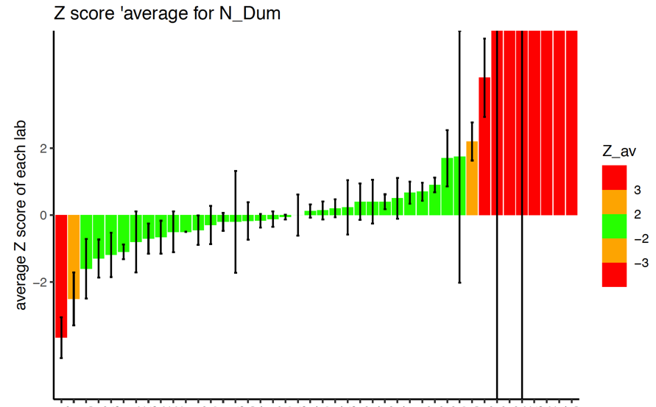
The human factor ?

Slide 84
Phosphorus

Slide 85
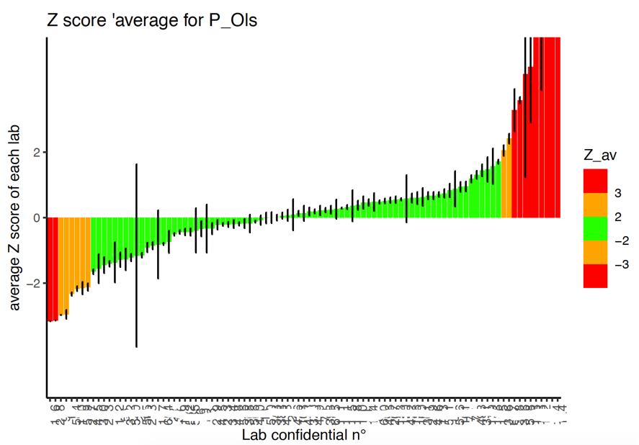

Slide 86
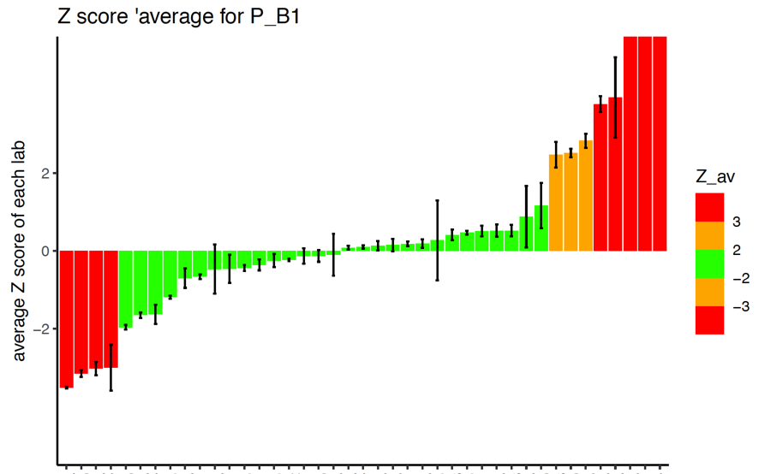

Slide 87
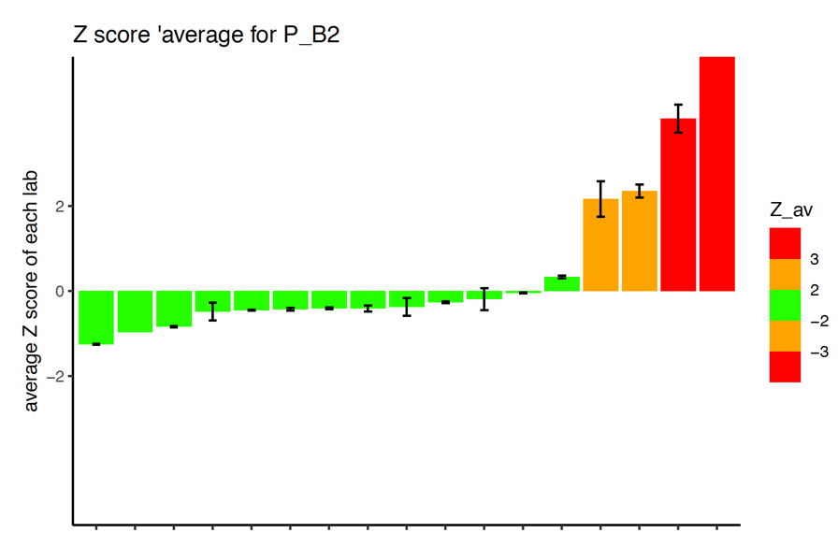

Slide 90
Part 1 = assessment:
how reliable and comparable are
the data produced by soil laboratories?

Slide 91
QUESTIONS: 2 + 1 more
RELIABILITY: for each lab, what is its precision?
many labs have insuficient precision: need to develop IQC

Slide 92
QUESTIONS: 2 + 1 more
RELIABILITY: for each lab, what is its precision?
many labs have insuficient precision: need to develop IQC
2. COMPARABILITY: among all labs, dispersion of their results?
Depends on method but even with high tech
Analytical problems &/or transcription mistakes ?

Slide 93
QUESTIONS: 2 + 1 more
RELIABILITY: for each lab, what is its precision?
many labs have insuficient precision: need to develop IQC
2. COMPARABILITY: among all labs, dispersion of their results?
Depends on method but even with high tech
Analytical problems &/or transcription mistakes ?
3. REFERENCE VALUE : at global scale,
consensus value = reference value : YES !

Slide 94
Done but need to go forward

Slide 95
Done but need to go forward
Record of performances but not yet certificates

Slide 96
- Organisation of regional PTs in 2023
Part 2 = future perspectives:
(suggestions to be discussed)
Which actions/activities
to improve all labs performances ?

Slide 97
let’s consider the laboratories as ‘factories producing data’
global situation of labs was a black box
GLOSOLAN has opend the dor and brought some light…
Soil lab
= black box
Analytical process 1
Analytical process 2
Report
(results, data)
client
storage
Analytical process 3
client
SOIL
registration
preparation
Analytical process 4
Analytical process etc
Keep the duration as short as possible

Slide 98
This is how it looks inside the ‘factory’:
pH
Carbon
Nitrogen
Report
(results, data)
client
storage
client
SOIL
registration
preparation
Phosphorus
CEC
Texture
Etc…

Slide 99
This is how it looks inside the ‘factory’:
This is what we have tested with GLOSOLAN PT
Carbon
Nitrogen
Report
(results, data)
client
storage
client
SOIL
registration
preparation
Phosphorus
What did we discover & what can be proposed?

Slide 100
This is how it looks inside the ‘factory’:
LACK OF INTERNAL QUALITY CONTROL
Carbon
Nitrogen
Report
(results, data)
client
storage
client
SOIL
registration
preparation
Phosphorus
For the analytical processes ?
For the transcription/ secretary processes ?

Slide 101
This is how it looks inside the ‘factory’:
LACK OF INTERNAL QUALITY CONTROL
Carbon
Nitrogen
Report
(results, data)
client
storage
client
SOIL
registration
preparation
Phosphorus
For the analytical processes ?
For the transcription/ secretary processes ?
Labs with poor ‘precision’ performances need to take action
Request GLOSOLAN members support or GSP/GLOSOLAN secretary
(confidentiality garanteed!)

Slide 102
EXTERNAL QUALITY CONTROL?
ABSOLUTELY NECESSARY BUT…
Cannot be organised by GLOSOLAN for all labs
REGIONAL PTs are necessary

Slide 103
EXTERNAL QUALITY CONTROL?

Slide 104
EXTERNAL QUALITY CONTROL?
ABSOLUTELY NECESSARY BUT…
Cannot be organised by GLOSOLAN for all labs

Slide 105
EXTERNAL QUALITY CONTROL?
ABSOLUTELY NECESSARY BUT…
Cannot be organised by GLOSOLAN for all labs
REGIONAL PTs are necessary… how to do?

Slide 106
REGIONAL PTs are necessary… how to do?
Each region or sub-region must organise PTs
Glosolan will organise GLOBAL PTs involving only high performing labs to assure accuracy and comparability

Slide 107
Human factor ?

Slide 108
Human factor ?
GLOSOLAN has done many activities to help labs
Now GLOSOLAN needs the help of high performing labs to train the less successful labs,
on a regular basis…

Slide 109
Human factor ?
GLOSOLAN has done many activities to help labs
Now GLOSOLAN needs the help of high performing labs to train the less successful labs,
on a regular basis…
Performances
All participants know where they are..

Slide 110
Human factor ?
GLOSOLAN has done many activities to help labs
Now GLOSOLAN needs the help of high performing labs to train the less successful labs,
on a regular basis…
Performances
All participants know where they are..

Slide 111
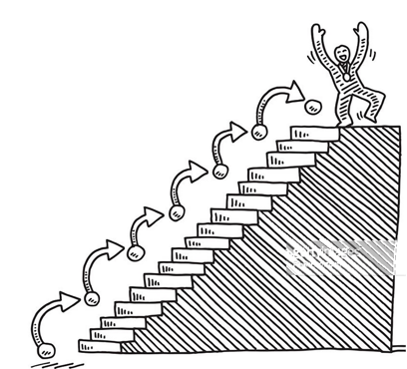
It is important to reach the highest step….
It is also important to help each other to reach
the highest step!

Slide 112
Human factor ?
GLOSOLAN has done many activities to help labs
Now GLOSOLAN needs the help of high performing labs to train the less successful labs,
on a regular basis…
Performances
FOR THE FUTURE
All participants know where they are..

Slide 113
Data are important
Health &
Safety too !
Precision
Accuracy
People &
environment

Slide 114
Data are important
Health &
Safety too !
Precision
Accuracy
People &
environment
On going, should develop…

Slide 115
Record of performances but not yet certificates

Slide 116
Thank you also to Lucrezia, Nok, Michael, Filippo, and many others who all joined the work that I presented. Without their dedication GLOSOLAN would not have such an unique vision of GLOBAL soil labs!
Thanks for your attention Thank you to PT participants

